Slide 1

Atlas RAG-based Multiple Choice QA
Team 8
Ankita Arvind Deshmukh
Meera Tresa Sebastian
Satyanadh Reddy Alavala

Slide 2
Experimental Arguments
--total_steps
number of epochs
--n_context
pass the top n passages from the retriever to the language model
--retriever_n_context
finetune the retriever with the top n passages
--index_mode {"flat"|"faiss"}
flat: exact match is more suitable than ANN
--retrieve_with_rerank
retrieve top L passages and re-rank
--weight_decay
penalize large weights
--lr & lr_retriever
learning rate
--dropout
percentage of neurons to be dropped
--temperature_gold and temperature_score
control the randomness of predictions

Slide 3
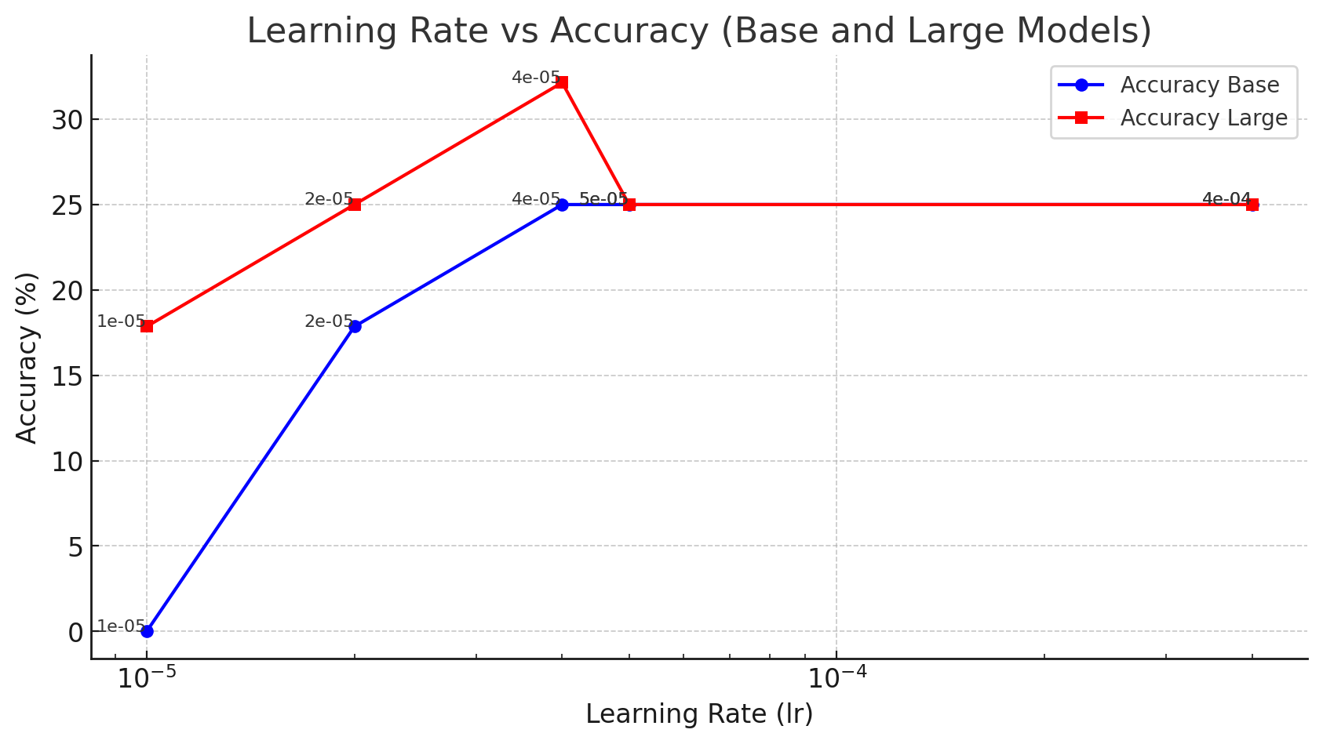
lr & lr_retriver
[1e-5 , 2e-5, 4e-5, 5e-5, 4e-4]
Dataset:
Train = 60
Val = 20
Test = 20

Slide 4
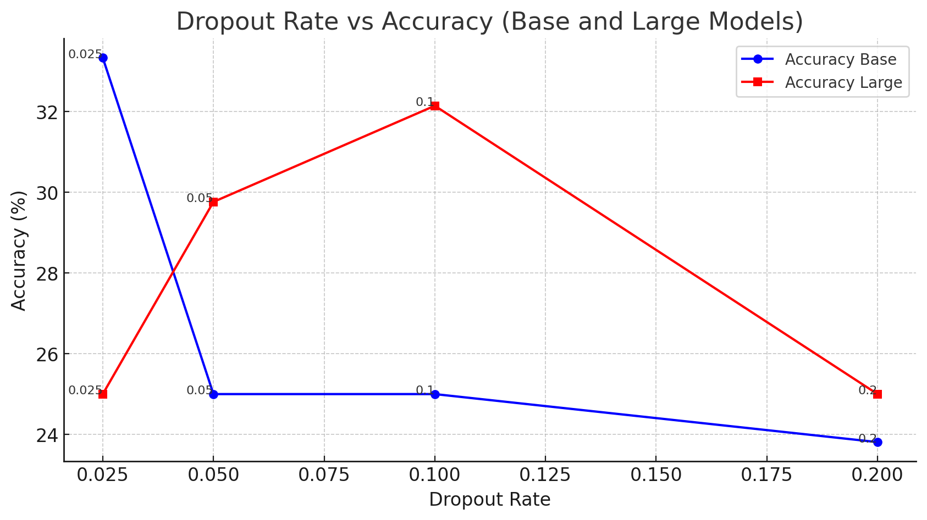
Dropout
[0.025, 0.05, 0.1, 0.2]
Dataset:
Train = 60
Val = 20
Test = 20

Slide 5
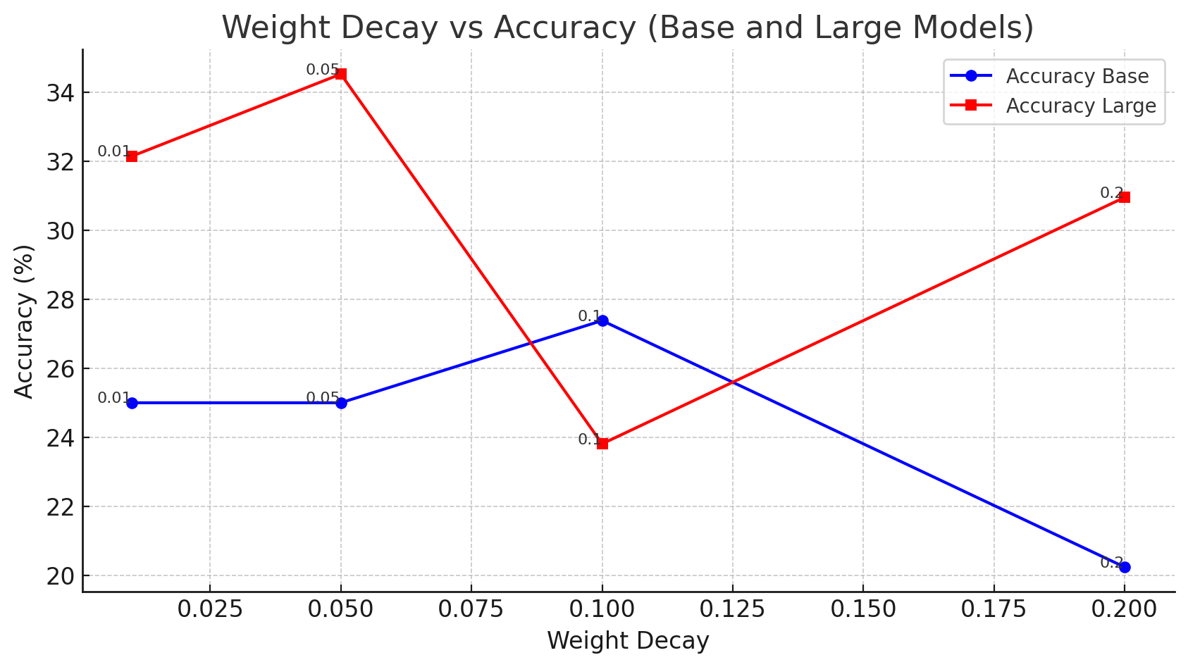
Weight Decay
[0.01, 0.05, 0.1, 0.2]
Dataset:
Train = 60
Val = 20
Test = 20

Slide 6
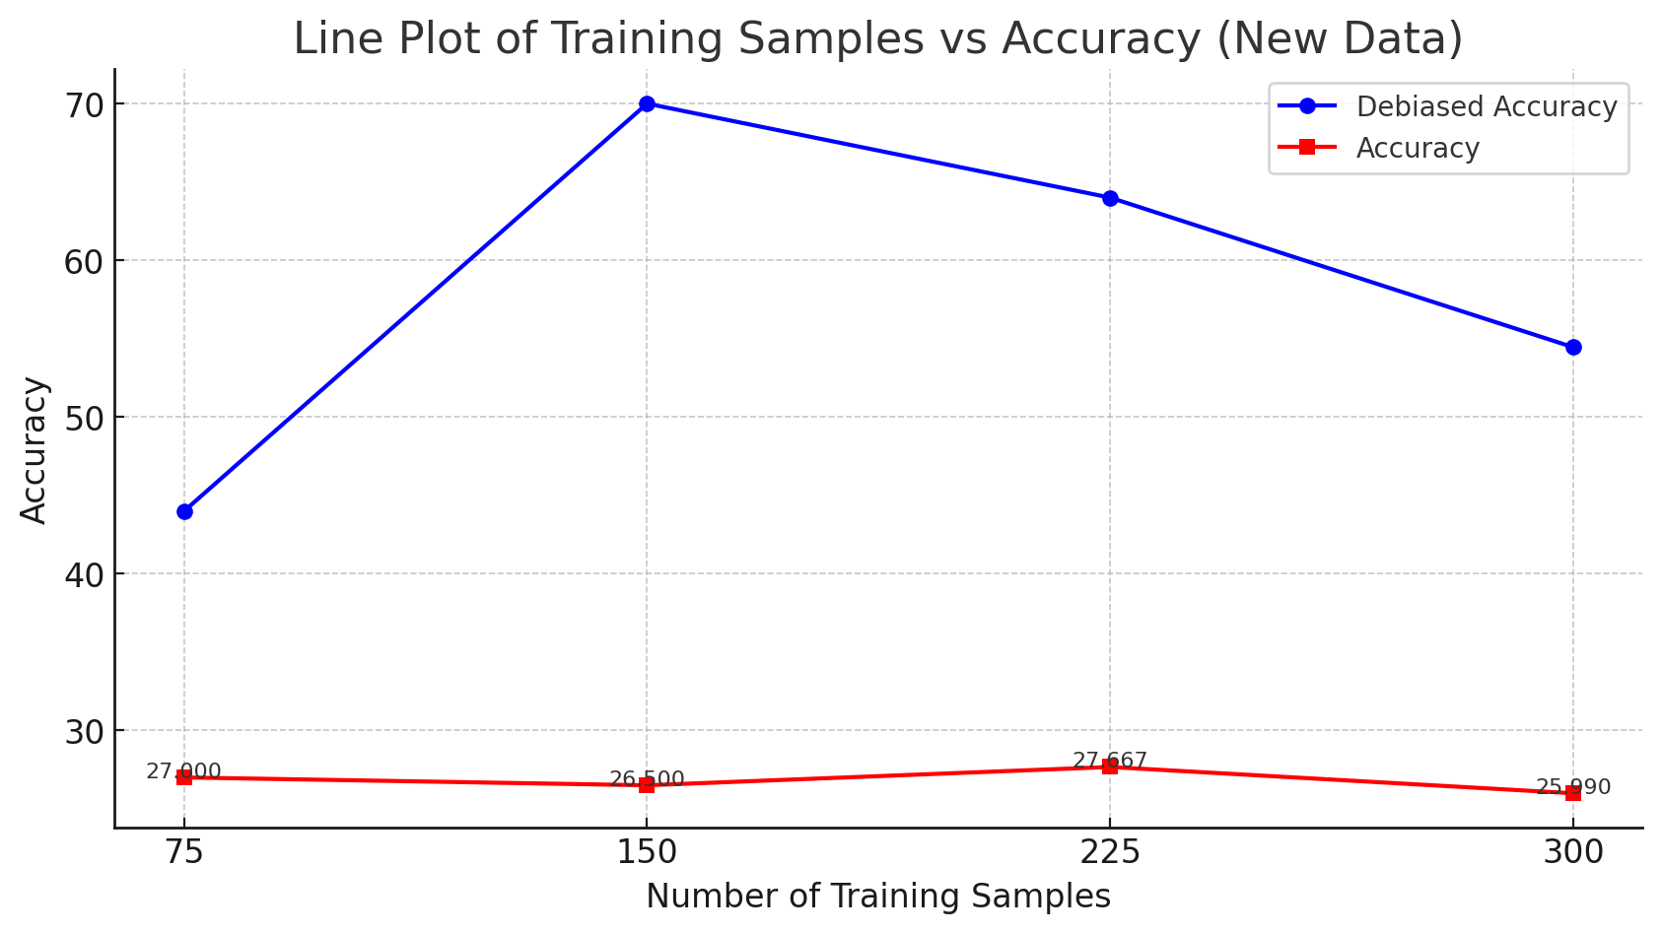
Increase Training Examples
lr = 4e-5
Dropout = 0.1
Weight_decay = 0.05
Model = large
Total Steps = 30

Slide 7
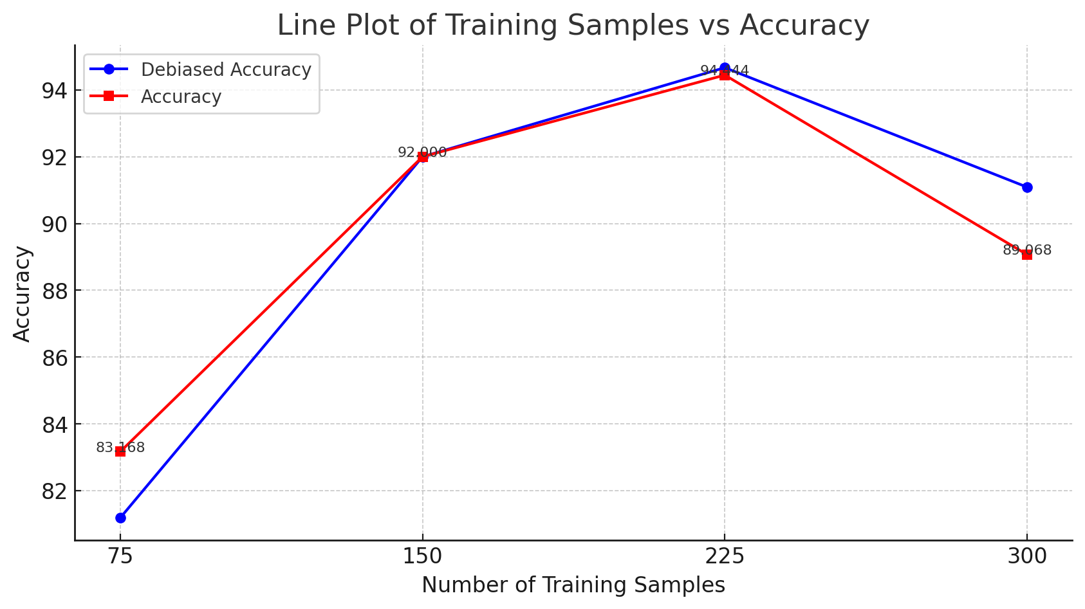
Increase Epochs
lr = 4e-5
Dropout = 0.1
Weight_decay = 0.05
Model = large
Epochs = 1000

Slide 8
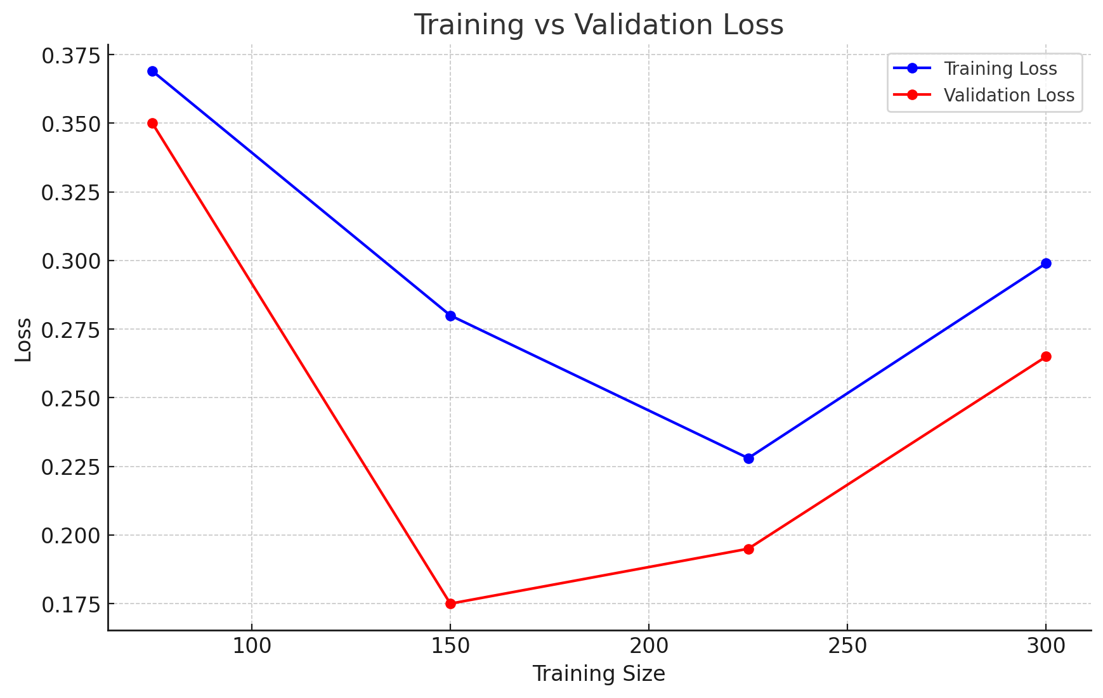
Train vs Eval
lr = 4e-5
Dropout = 0.1
Weight_decay = 0.05
Model = large
Total Steps = 1000

Slide 9
Example Answers
"question": "How do one-dimensional convolutional neural networks treat sequences of vectors?", "options": {"A": "As a static image", "B": "As an image that it slides along", "C": "As random noise", "D": "As individual data points"}, "answer": "B", "is_original": false, "uid": "How do one-dimensional convolutional neural networks treat sequences of vectors?As individual data points As a static image As an image that it slides along As random noise"}, "choice_logits": {"A": -7.380085468292236, "B": 3.2698183059692383, "C": -8.554068565368652, "D": -9.536116600036621}}]}
{"query": "question: How do one-dimensional convolutional neural networks treat sequences of vectors? options: (A) As individual data points (B) As a static image (C) As an image that it slides along (D) As random noise answer: <extra_id_0>", "answers": ["C"]
"question": "How do one-dimensional convolutional neural networks treat sequences of vectors?", "options": {"A": "As individual data points", "B": "As a static image", "C": "As an image that it slides along", "D": "As random noise"}, "answer": "C”, "choice_probs": {"A": 4.859535692958161e-06, "B": 1.0709660273278132e-05, "C": 0.9999798536300659, "D": 4.593858648149762e-06}

Slide 10
Example Answers
"question": "Which model capture the true relationship more accurately for stock market data.", "options": {"A": "LDA ", "B": "logistic regression ", "C": "simple regression", "D": "QDA "}, "answer": "D” "choice_logits": {"A": 2.037598133087158, "B": 2.7861595153808594, "C": 3.110187292098999, "D": 2.767043113708496}}]}
{"query": "question: Which model capture the true relationship more accurately for stock market data. options: (A) QDA (B) LDA (C) logistic regression (D) simple regression answer: <extra_id_0>", "answers": ["A"]
"question": "Which model capture the true relationship more accurately for stock market data.", "options": {"A": "QDA ", "B": "LDA ", "C": "logistic regression ", "D": "simple regression"}, "answer": "A", "choice_probs": {"A": 0.2551685571670532, "B": 0.23074574768543243, "C": 0.2511557340621948, "D": 0.2629299759864807}

Slide 11
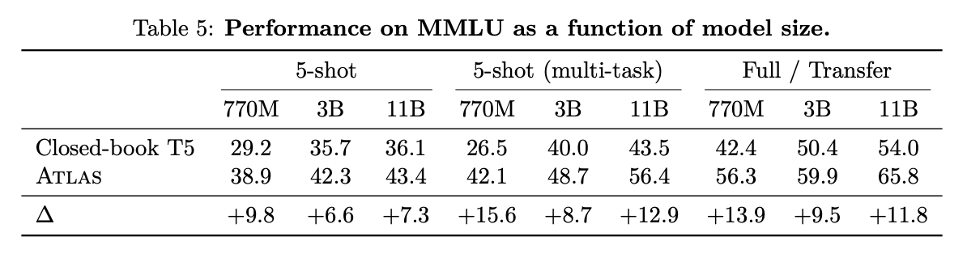
Comparison with Atlas Paper
lr = 4e-5
Dropout = 0.1
Weight_decay = 0.05
Model = large
Total Steps = 1000
Training Examples = 150
Accuracy = ~92%

Slide 12
Experiment Settings
Models Chosen: Pretrained Atlas large and base model
Fine Tuning: [5, 10, 20, 30, 50, 100] examples from the MCQ dataset generated by our team
Validation: Random 20 MCQ examples contributed by other teams
Evaluation: Random 248 MCQ examples contributed by other teams
Passages: unified_passages.jsonl dataset provided - 1054 passages

Slide 13
Experiments performed
Fine-tuning experiments for the large model and 50/100 examples
fp32 over bf16 (FP32 is preferred when high precision is crucial, while BF16 may be suitable for applications where a balance between precision and computational efficiency)
Multiple_choice_eval_permutations - all,cyclic
Multiple_choice_train_permutations - all, cyclic
retrieve_with_rerank - pass this to enable reranking with fresh passage encoder for retriever along with index refresh
retriever_n_context - finetune the retriever with the top 40 passages
n_context - pass the top 40 passages from the retriever to the language model
total_steps - train for this many steps - 1000
dropout 0.1 --weight_decay 0.01 --lr 4e-5
Evaluated on [0,5,10,20,30,50 and 100] training examples
Base v/s Large comparison for no-finetune, 10 and 100 training examples
Number of training steps/epochs [128,256,512,1024,2048]
Learning rate - [1e5 to 4e5]
Gold Score Mode - [emdr,pdist,loop]

Slide 14
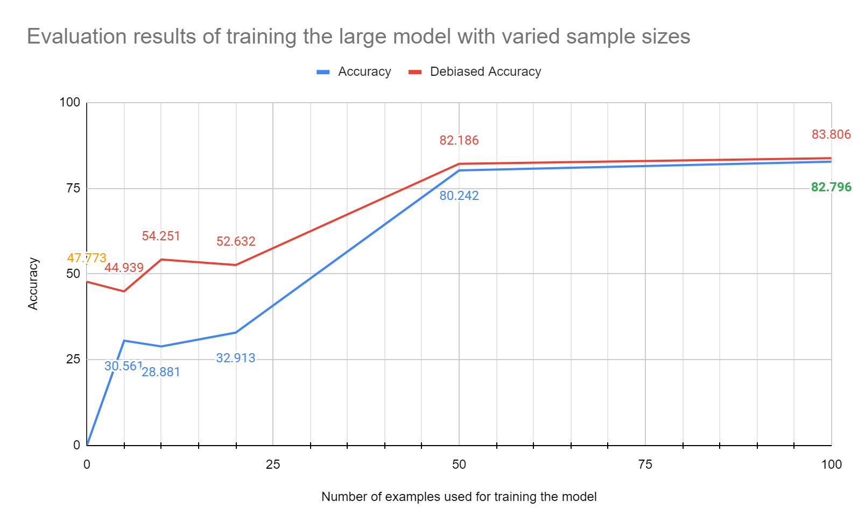
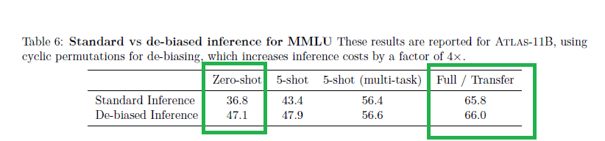
Number of training examples
Model = large
Total Steps = 1000
Number of training examples: [0,5,10,20,30,50, 100]

Slide 15
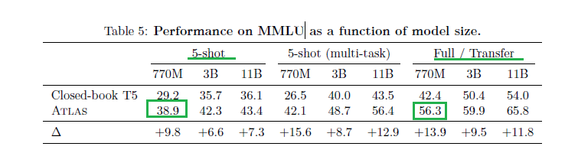
Number of training examples and Atlas Paper
Between 5-shot to full (increasing the sample size), Atlas performed +17.4 better for the large model. For our MCQ data set, fine tuning from 10 to 100 examples, the accuracy improved by +53.915 for the same large model.
lr = 4e-5
Dropout = 0.1
Weight_decay = 0.01
Model = large
Total Steps = 1000
Training Examples = 100
Accuracy = ~83%

Slide 16
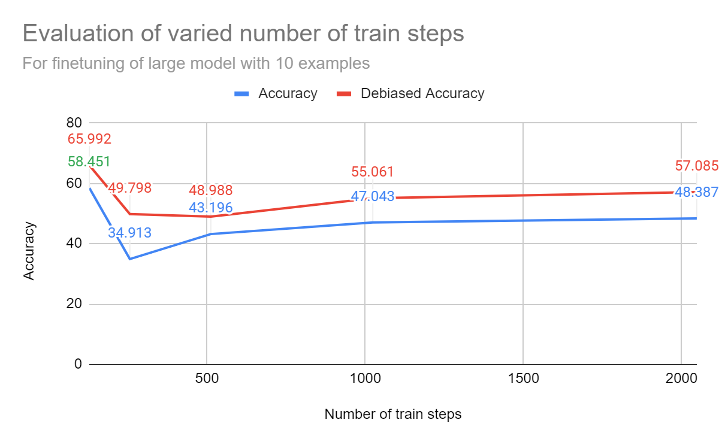
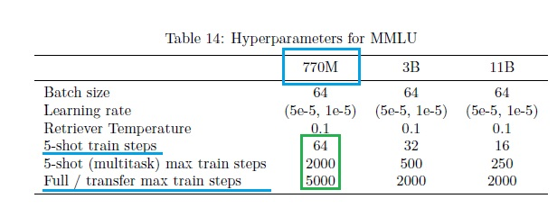
Epochs/Total Steps
Model = large
Number of training examples = 10
Total Steps: [128,256,512,1024,2048]

Slide 17
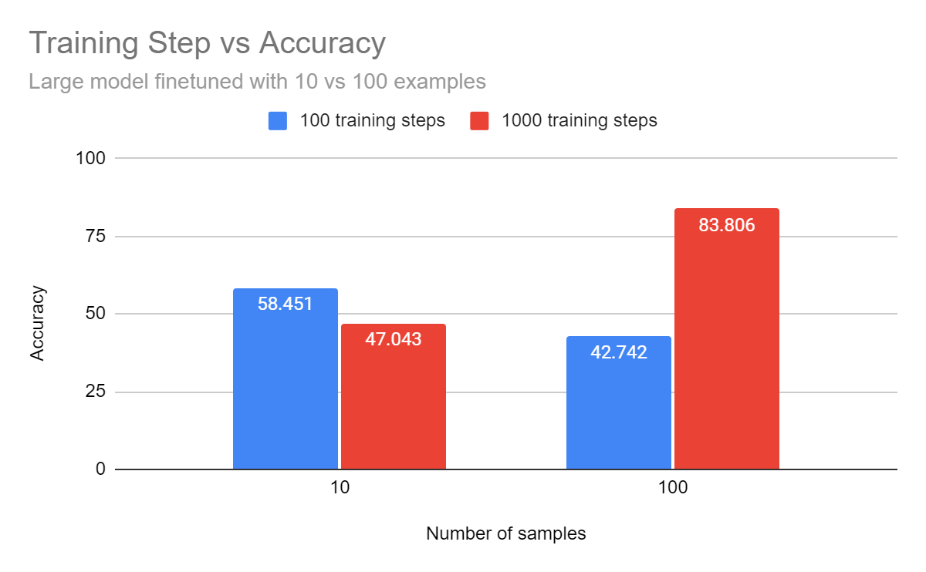
Training Steps and Different Number of Samples
Model = large
Number of training examples = [10,100]
Number of epochs(total_steps) = [100,1000]

Slide 18
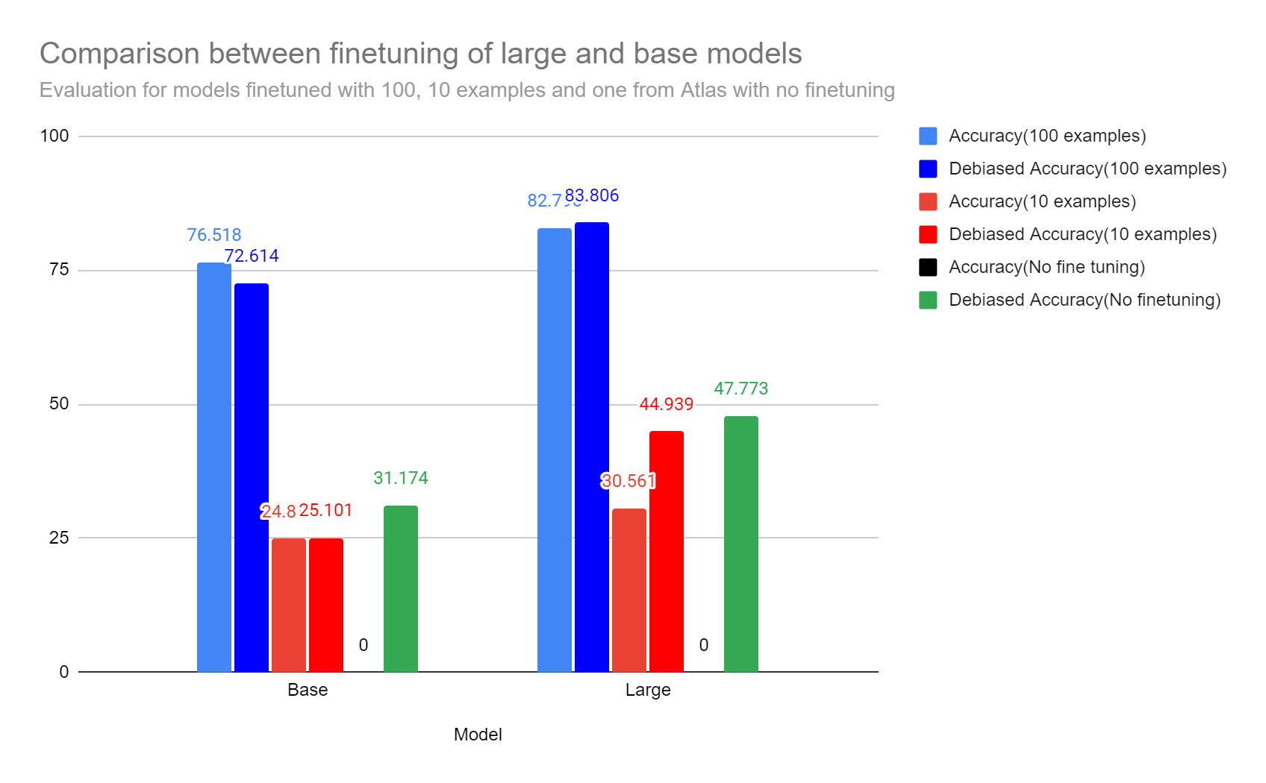
Large v/s Base
Model = large, base
Number of training examples =
[10,100, without fine tuning]

Slide 19
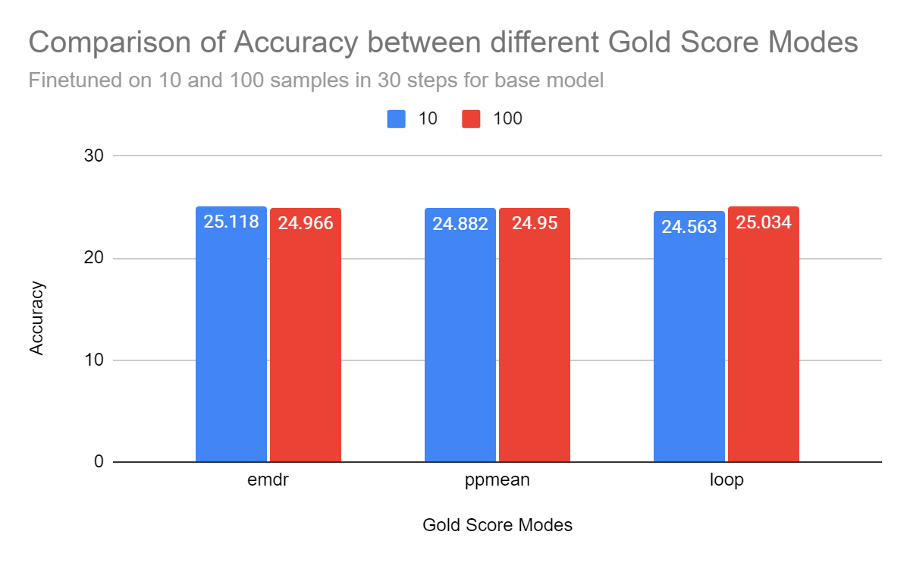
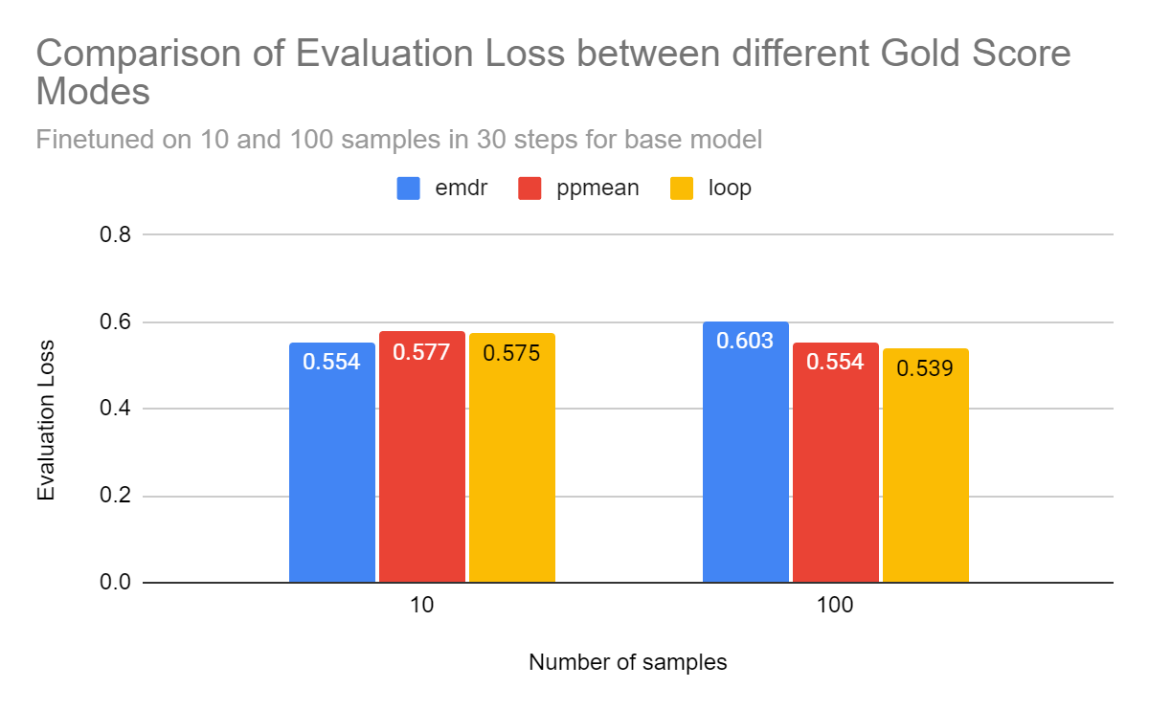
Gold Score Mode
Training objective for the retriever
Model: Base
Number of Samples: [10, 100]
Gold Score Mode: [emdr, ppmean/pdist, loop]
End-to-end training of Multi-Document Reader and Retriever (EMDR)
Perplexity Distillation (PDist)
Leave-one-out Perplexity Distillation (LOOP)

Slide 20
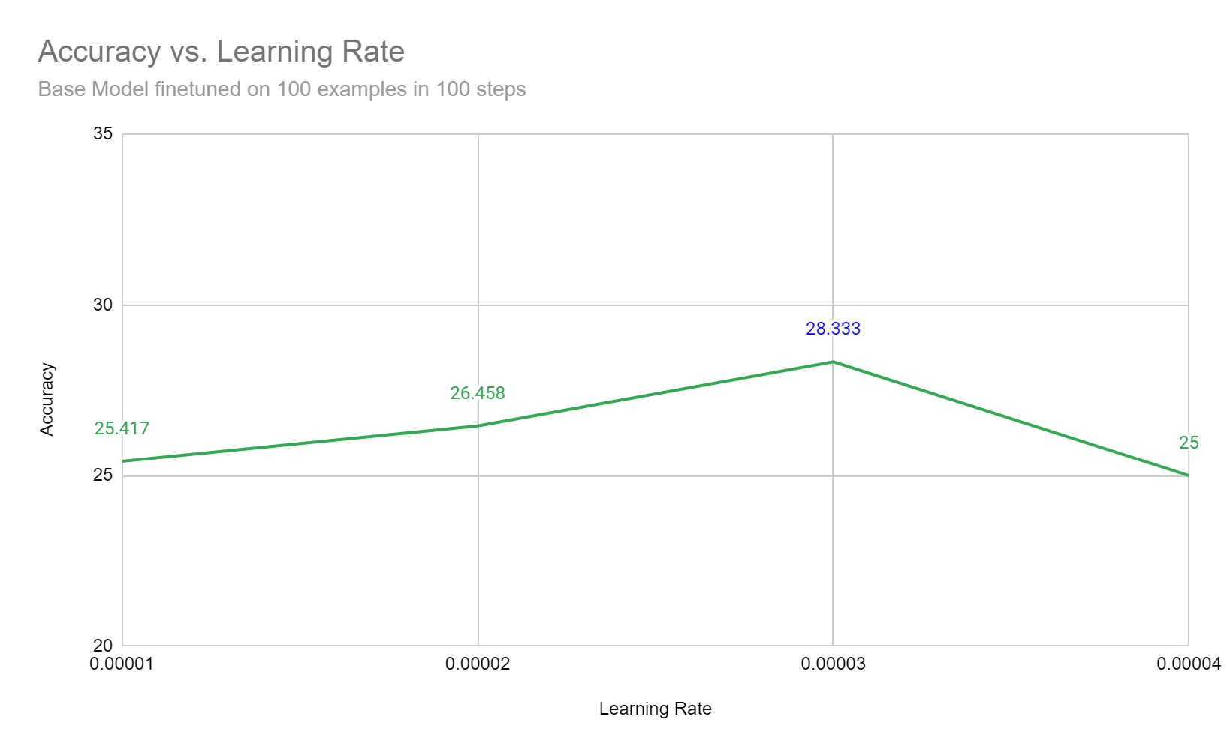
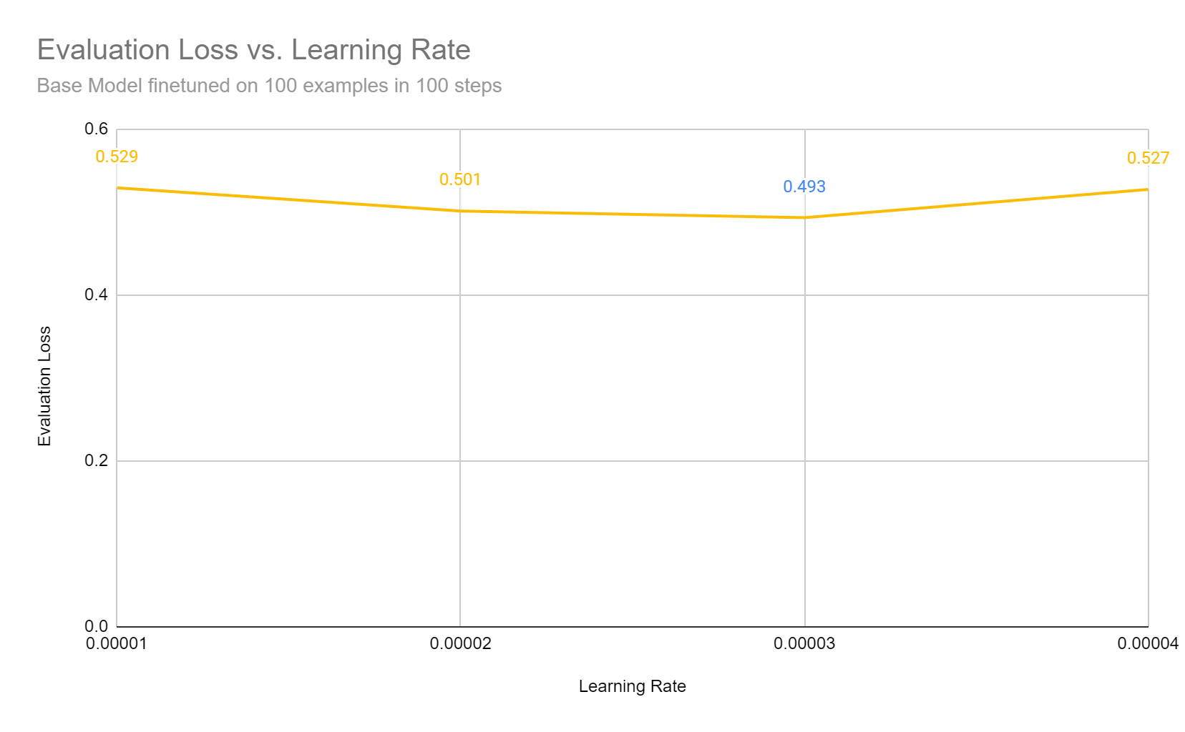
Learning Rate
Model: Base
Number of examples: 100
Epochs: 100
Learning Rate: [1e-5,2e-5,3e-5,4e-5]

Slide 21
Examples from Training Dataset of MCQs
"question": "Which of the following linkages in hierarchical clustering can cause undesirable inversions?", "options": {"A": "Complete.", "B": "Single.", "C": "Average.", "D": "Centroid."}, "answer": "D"}
"question": "What is the tree-based representation resulting from hierarchical clustering?", "options": {"A": "Dendogram.", "B": "Spectrograms.", "C": "Venn Diagram.", "D": "Sequence diagrams"}, "answer": "A"}

Slide 22
Example outputs
question: What is the general concept of statistical learning?
options: (A) Analyze error term (B) Estimate input-output relationship (C) Increase sales (D) Predict sales
"answers": ["B"]
Model trained with --retrieve_with_rerank and -n_to_rerank_with_retrieve_with_rerank 128
"generation": "B"
Passage 1:In order to motivate our study of statistical learning, we begin with a simple example. Suppose that we are statistical consultants hired by a client to investigate the association between advertising and sales of a particular product. The Advertising data set consists of the sales of that product in 200 different markets, along with advertising budgets for the product in each of those markets for three different media: TV, radio, and newspaper. It is not possible for our client to directly increase sales of the product. On the other hand, they can control the advertising expenditure in each of the three media. Therefore, if we determine that there is an association between advertising and sales, then we can instruct our client to adjust advertising budgets, thereby indirectly increasing sales. In other words, our goal is to develop an accurate model that can be used to predict sales on the basis of the three media budgets.
Passage 2: Statistical learning, in essence, is the process of using a set of approaches to estimate the relationship between input variables (such as X1, X2, X3) and output variables (Y). It aims to understand and quantify how these input variables are related to the output variable, allowing us to make predictions or gain insights based on this relationship.
Model trained without --retrieve_with_rerank
"generation": "D"
Passage 1: More generally, suppose that we observe a quantitative response Y and p different predictors, X1, X2, . . . , Xp. We assume that there is some relationship between Y and X = (X1,X2, . . . ,Xp), which can be written in the very general form Y = f(X) + epsilon. Here f is some fixed but unknown function of X1, . . . ,Xp, and epsilon is a random error term, which is independent of X and has mean zero."
Passage 2: Statistical learning, in essence, is the process of using a set of approaches to estimate the relationship between input variables (such as X1, X2, X3) and output variables (Y). It aims to understand and quantify how these input variables are related to the output variable, allowing us to make predictions or gain insights based on this relationship.

Slide 23
Experiment Setup
Data Splitting
Training - 70%
Testing - 15%
Evaluation - 15%
Subsets for Training & Evaluation:
10% (Training: 28, Evaluation: 6)
20% (Training: 56, Evaluation: 12)
50% (Training: 140, Evaluation: 30)
100% (Training: 280, Evaluation: 60)

Slide 24
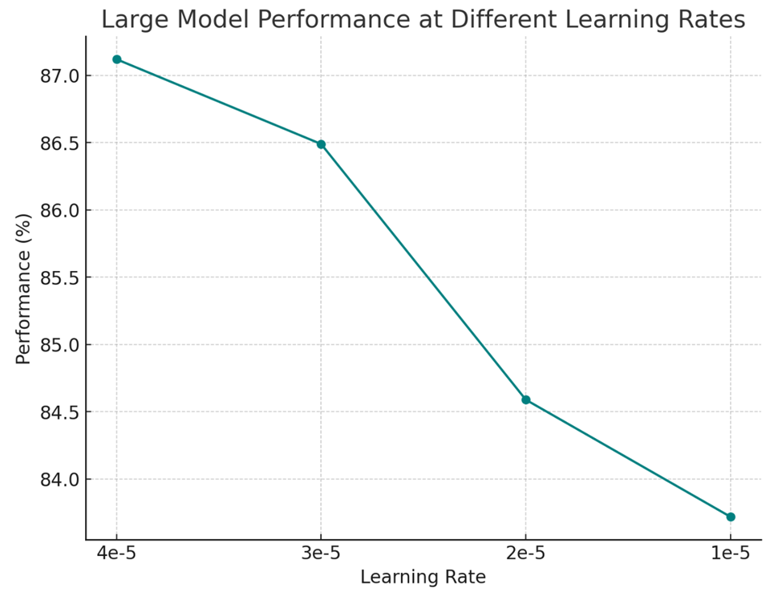
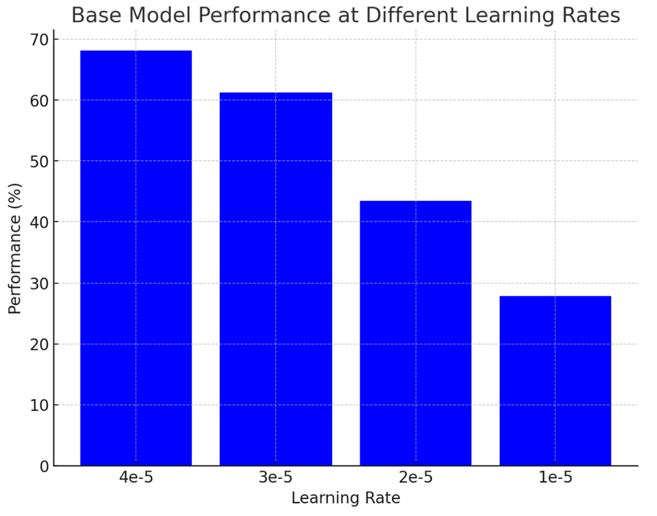
Learning rate / Performance

Slide 25
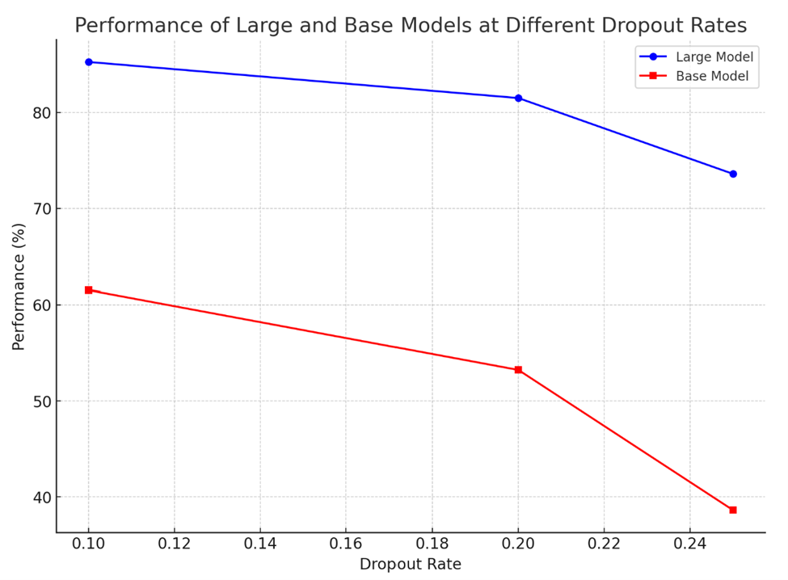
Dropout / Performance
Model: BASE
Sample Size: 80%
Epochs: 500
Model: LARGE
Sample Size: 80%
Epochs: 500

Slide 26
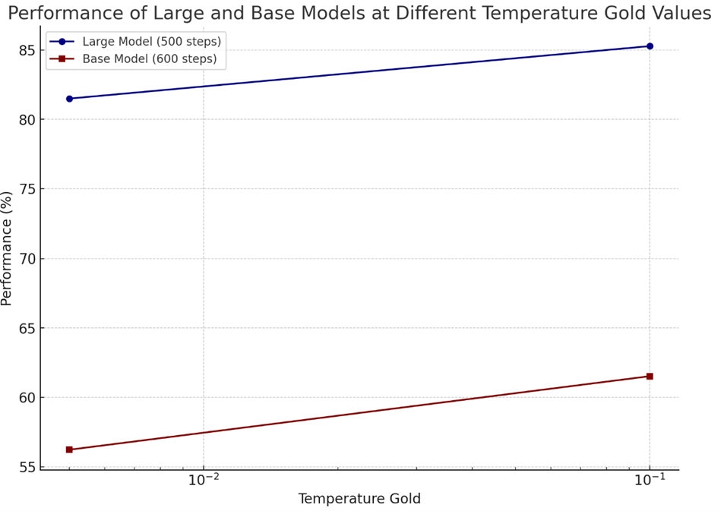
Temperature Gold / Performance
Model: BASE
Sample Size: 50%
Training Steps: 600
Model: Large
Sample Size: 50%
Training Steps:500

Slide 27
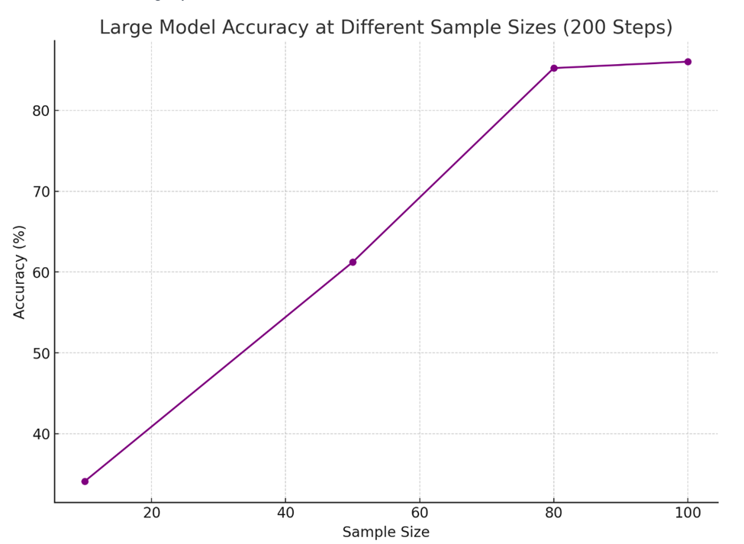
Sample Sizes / Performance
Model: Large
Training Steps: 200

Slide 28
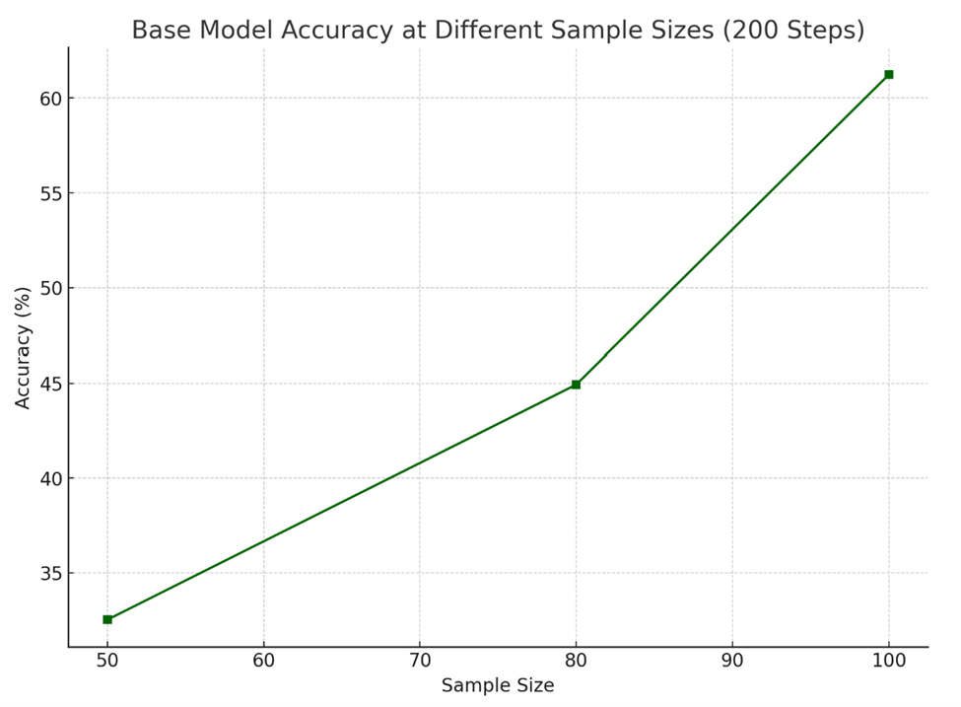
Sample Sizes / Performance
Model: Base
Training Steps: 200

Slide 29
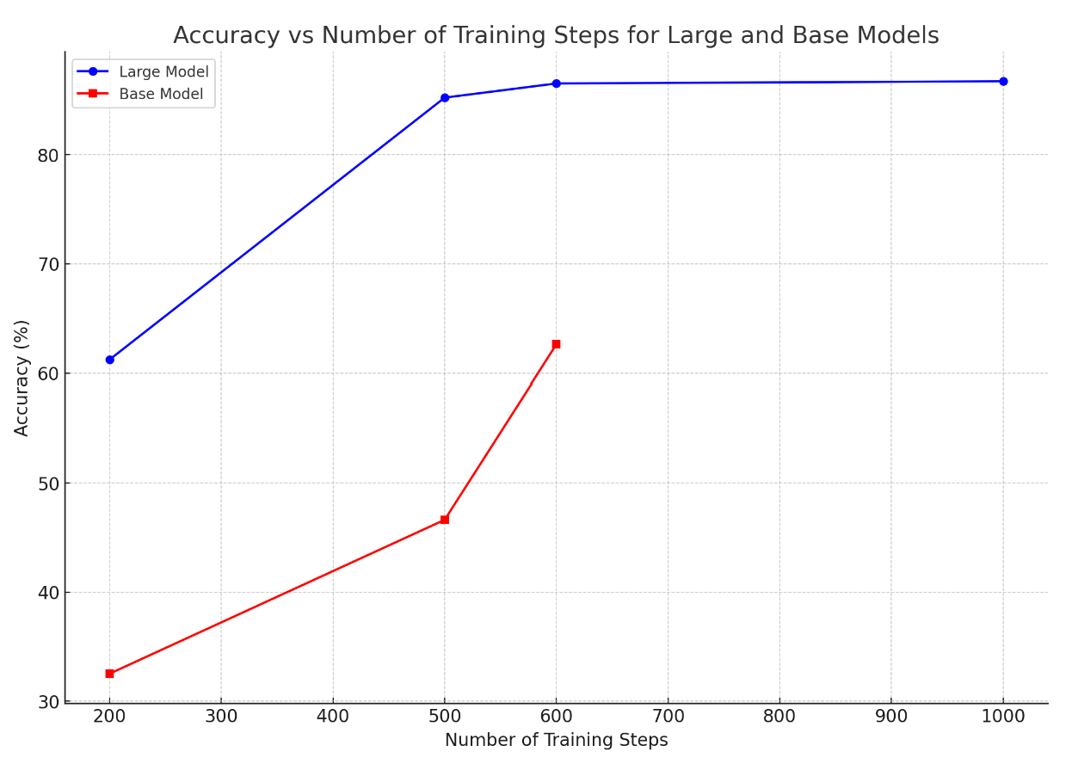
Training Steps / Performance
Model: Base
Sample Size: 80
Model: Large
Sample Size: 80

Slide 30
Challenges
Initial error in MCQ dataset
HPC unavailability
CUDA memory issue
High training time for larger models

Slide 31
THANK YOU !

